Slide 1
𝔦-TiRE: Incremental Timed-Release Encryption
or
How to use Timed-Release Encryption on Blockchains?
CCS 2022
Leemon Baird Pratyay Mukherjee Rohit Sinha
Swirlds Labs
王亚龙 2024.06.14

Slide 2
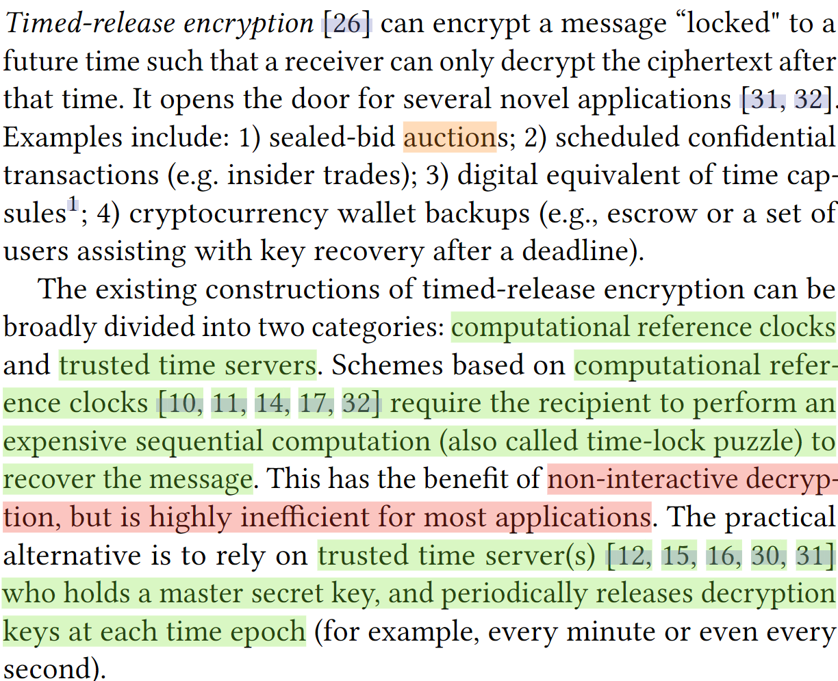
Introduction
应用场景：
密封投标拍卖
预定保密交易
数字时间胶囊
…

Slide 3
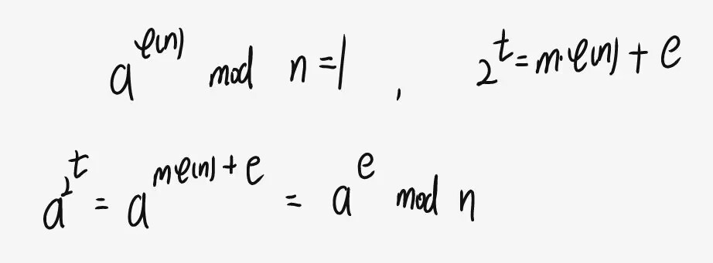
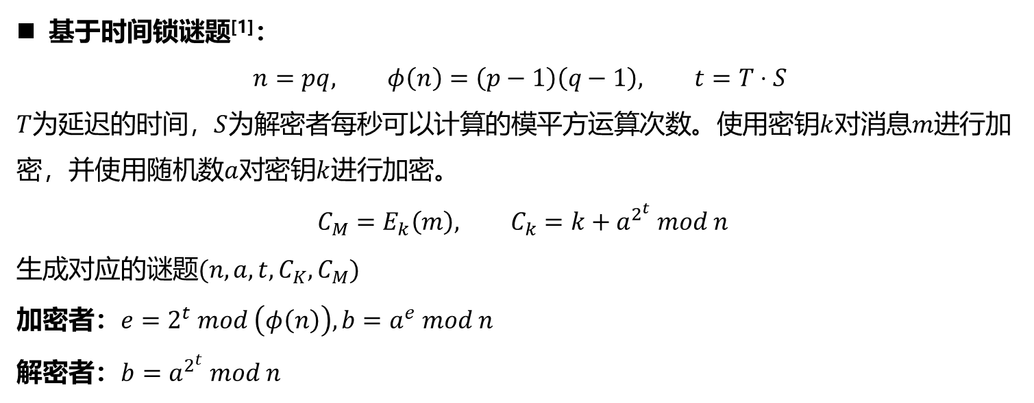

Time-lock puzzle
基于时间锁谜题^{[1]}：
$$n=pq, φ\left(n\right)=\left(p−1\right)\left(q−1\right), t=T⋅S$$
$T$为延迟的时间，$S$为解密者每秒可以计算的模平方运算次数。使用密钥$k$对消息$m$进行加密，并使用随机数$a$对密钥$k$进行加密。
$$C_{M}=E_{k}\left(m\right), C_{k}=k+a^{2^{t}} mod n$$
生成对应的谜题$(n,a,t,C_{K},C_{M})$
加密者：$e=2^{t} mod \left(φ\left(n\right)\right), b=a^{e} mod n$
解密者：$b=a^{2^{t}} mod n$
拥有陷门$φ(n)$时可以快速计算$b$
[1] Ronald L. Rivest, Adi Shamir, and David A. Wagner. 1996. Time-lock puzzles and timed-release crypto. Technical Report.

Slide 4
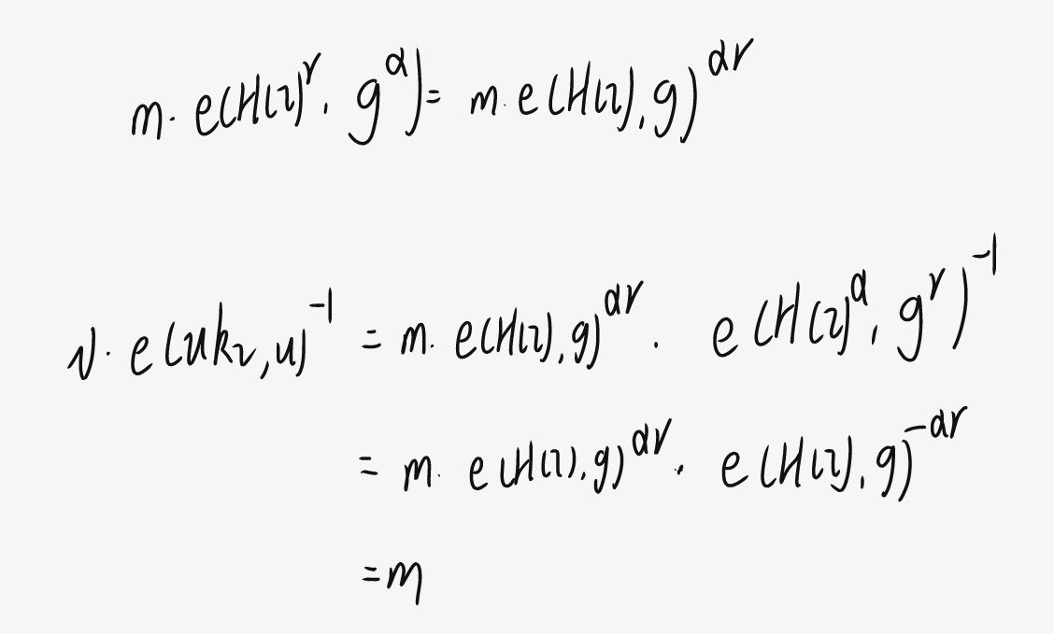
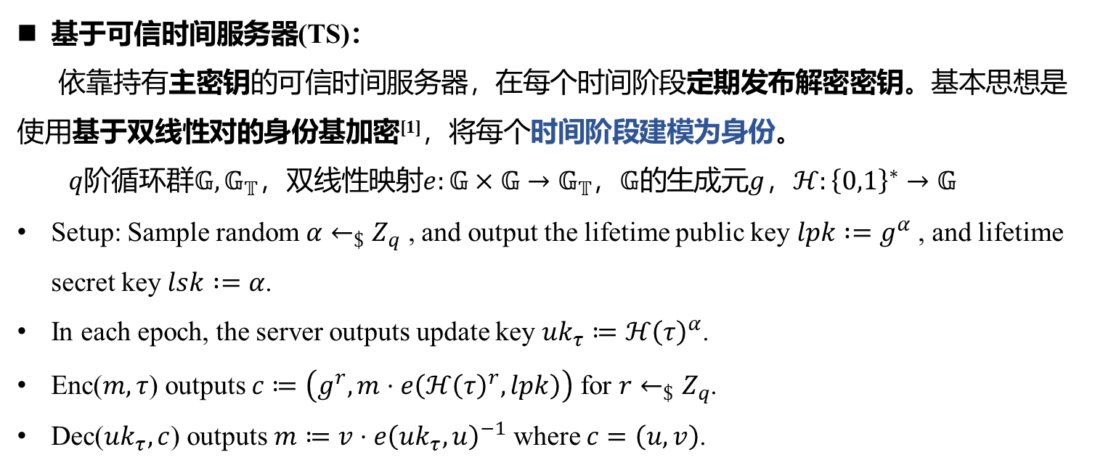
Trusted time servers
基于可信时间服务器(TS)：
依靠持有主密钥的可信时间服务器，在每个时间阶段定期发布解密密钥。基本思想是使用基于双线性对的身份基加密^{[1]}，将每个时间阶段建模为身份。
$q$阶循环群$𝔾, 𝔾_{𝕋}$，双线性映射$e:𝔾×𝔾→𝔾_{𝕋}$，$𝔾的$生成元$g$，$ℋ:{\left\{0,1\right\}}^{∗}→𝔾$
Setup: Sample random $α←_{\$}Z_{q}$ , and output the lifetime public key $lpk :=g^{α}$, and lifetime secret key $lsk :=α$.
In each epoch, the server outputs update key $uk_{τ}≔ℋ{\left(τ\right)}^{α}$.
Enc($m, τ$) outputs $c≔\left(g^{r},m⋅e\left(ℋ{\left(τ\right)}^{r},lpk\right)\right)$ for $r←_{\$}Z_{q}$.
Dec($uk_{τ},c$) outputs $m≔v⋅e{\left(uk_{τ}, u\right)}^{−1}$ where $c=\left(u,v\right)$.
无法简洁的表示$τ$阶段的解密密钥，链上存储与系统生命周期呈线性增长
[1] Dan Boneh and Matthew K. Franklin. 2001. Identity-Based Encryption from the Weil Pairing. In CRYPTO 2001 (LNCS, Vol. 2139), Joe Kilian (Ed.).

Slide 5
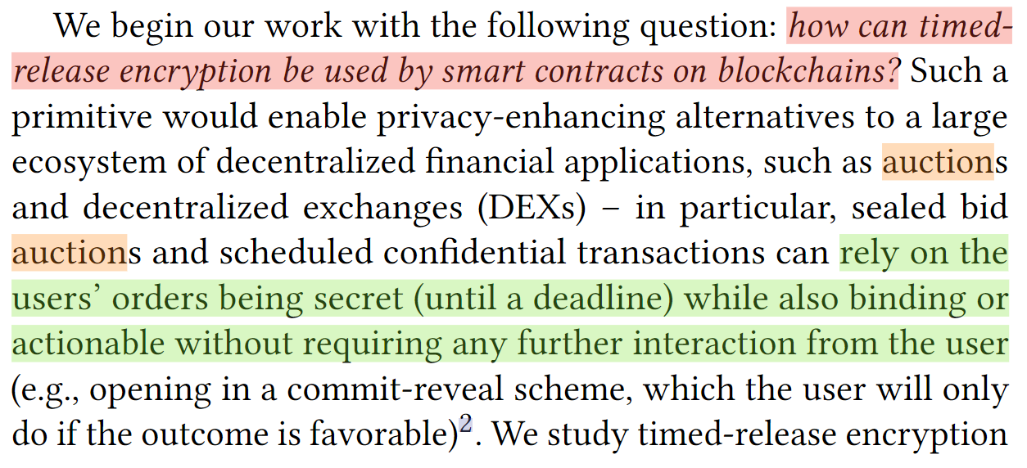
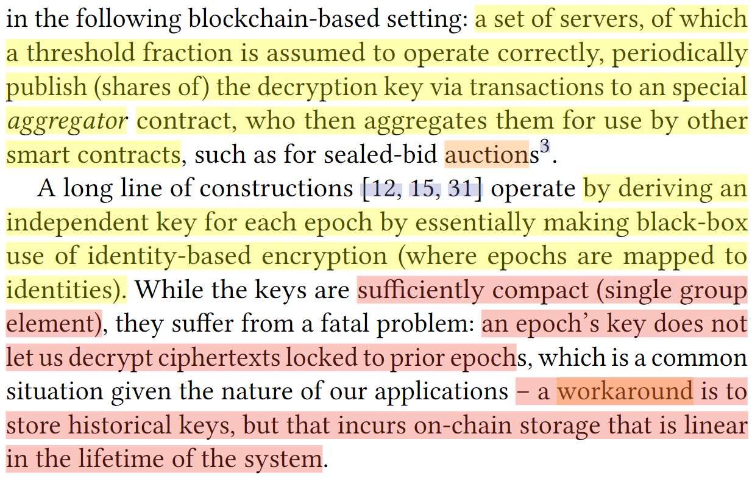
Introduction

Slide 6
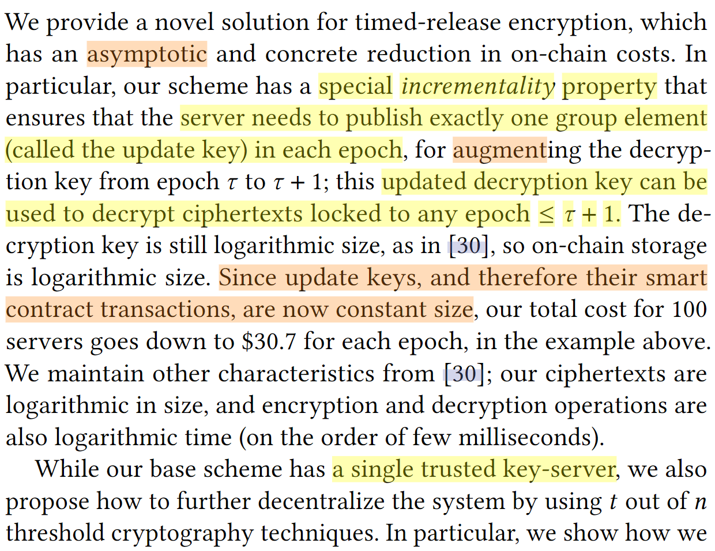
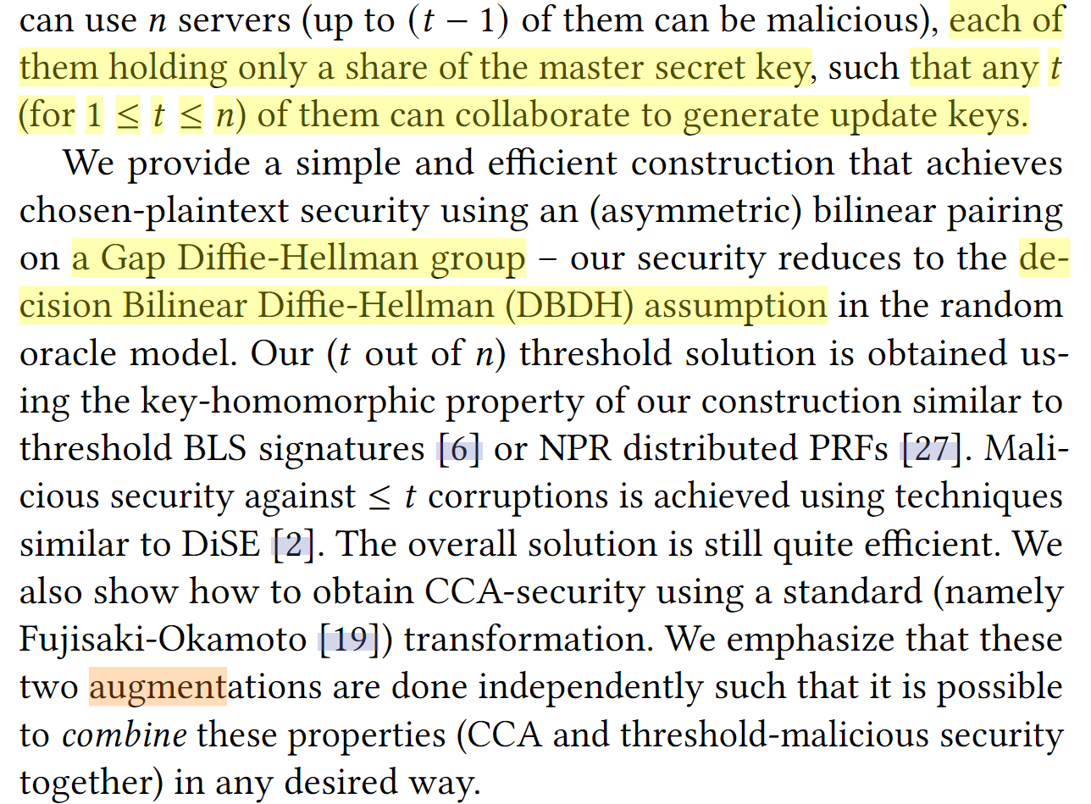
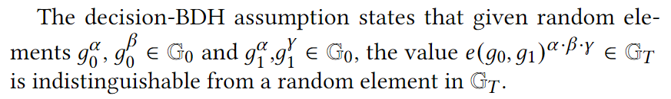
Contribution

Slide 7
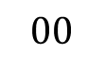
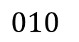
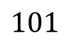
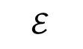
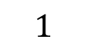
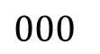
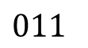
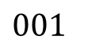
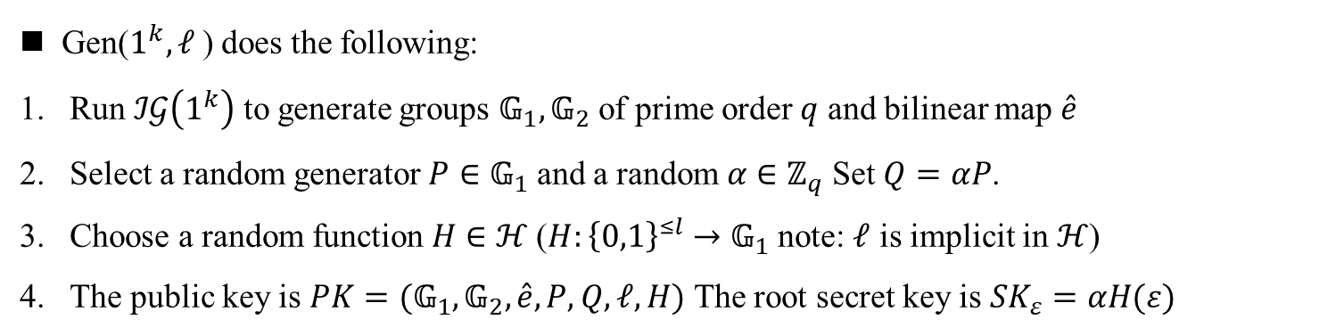
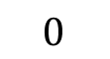
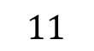
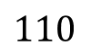
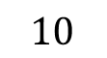
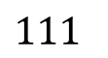
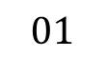
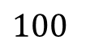
Binary tree encryption
$$ℰ$$
$$0$$
$$1$$
$$00$$
$$01$$
$$10$$
$$11$$
$$000$$
$$001$$
$$010$$
$$011$$
$$100$$
$$101$$
$$110$$
$$111$$
Gen($1^{k},ℓ$) does the following:
Run $ℐ𝒢\left(1^{k}\right)$ to generate groups $𝔾_{1}, 𝔾_{2}$ of prime order $q$ and bilinear map $\hat{e}$
Select a random generator $P∈𝔾_{1}$ and a random $α∈ℤ_{q}$Set $Q=αP$.
Choose a random function $H∈ℋ$($H:{\left\{0,1\right\}}^{≤l}→𝔾_{1}$ note: $ℓ$ is implicit in $ℋ$)
The public key is $PK=(𝔾_{1},𝔾_{2},\hat{e},P,Q,ℓ,H)$ The root secret key is $SK_{ε}=αH(ε)$
[1] Canetti R, Halevi S, Katz J. A forward-secure public-key encryption scheme[C]//Advances in Cryptology—EUROCRYPT 2003.

Slide 8
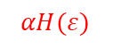

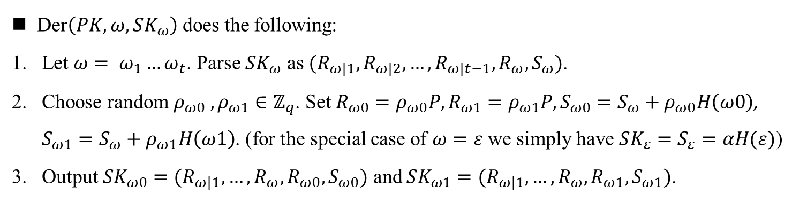

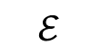


Binary tree encryption
$$αH(ε)$$
$$ℰ$$
$$ρ_{0}H(0)+ αH(ε)$$
$$ρ_{1}H(1)+ αH(ε)$$
$$0$$
$$1$$
$$ρ_{0}H(0)+ρ_{00}H(00)+ αH(ε)$$
$$ρ_{0}H(0)+ρ_{01}H(01)+ αH(ε)$$
$$00$$
$$01$$
$$10$$
$$11$$
$$000$$
$$001$$
$$010$$
$$011$$
$$100$$
$$101$$
$$110$$
$$111$$
Der$\left(PK,ω,SK_{ω}\right)$ does the following:
Let $ω= ω_{1}…ω_{t}$. Parse $SK_{ω}$ as $(R_{ω|1},R_{ω|2}, …,R_{ω|t−1},R_{ω},S_{ω})$.
Choose random $ρ_{ω0} ,ρ_{ω1}∈ℤ_{q}$. Set $R_{ω0}=ρ_{ω0}P,R_{ω1}=ρ_{ω1}P,S_{ω0}=S_{ω}+ρ_{ω0}H\left(ω0\right)$, $S_{ω1}=S_{ω}+ρ_{ω1}H\left(ω1\right)$. (for the special case of $ω=ε$ we simply have $SK_{ε}=S_{ε}=αH(ε)$)
Output $SK_{ω0}=(R_{ω|1},…,R_{ω},R_{ω0},S_{ω0})$ and $SK_{ω1}=(R_{ω|1},…,R_{ω},R_{ω1},S_{ω1})$.
[1] Canetti R, Halevi S, Katz J. A forward-secure public-key encryption scheme[C]//Advances in Cryptology—EUROCRYPT 2003.

Slide 9
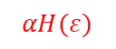

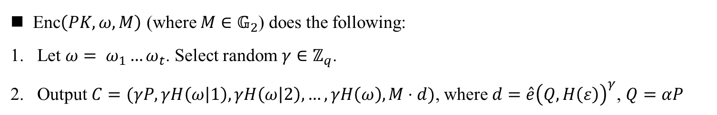



Binary tree encryption
$$αH(ε)$$
$$ℰ$$
$$ρ_{0}H(0)+ αH(ε)$$
$$ρ_{1}H(1)+ αH(ε)$$
$$0$$
$$1$$
$$ρ_{0}H(0)+ρ_{00}H(00)+ αH(ε)$$
$$ρ_{0}H(0)+ρ_{01}H(01)+ αH(ε)$$
$$00$$
$$01$$
$$10$$
$$11$$
$$000$$
$$001$$
$$010$$
$$011$$
$$100$$
$$101$$
$$110$$
$$111$$
Enc$\left(PK,ω,M\right)$ (where $M∈𝔾_{2}$) does the following:
Let $ω= ω_{1}…ω_{t}$. Select random $γ∈ℤ_{q}$.
Output $C=(γP,γH\left(ω | 1\right),γH\left(ω | 2\right),…,γH\left(ω\right),M⋅d)$, where $d=\hat{e}{\left(Q, H\left(ε\right)\right)}^{γ}$, $Q=αP$
[1] Canetti R, Halevi S, Katz J. A forward-secure public-key encryption scheme[C]//Advances in Cryptology—EUROCRYPT 2003.

Slide 10
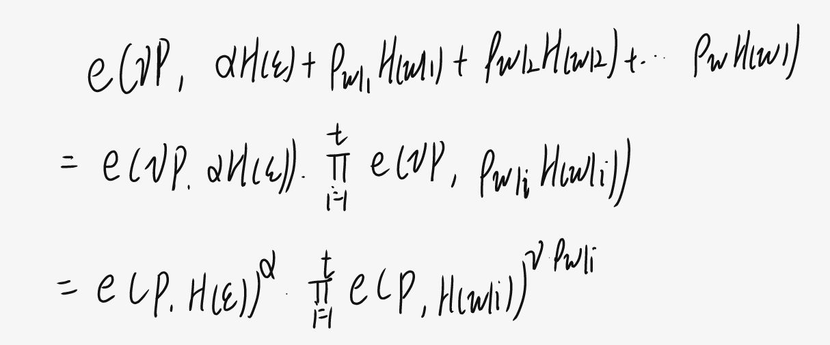
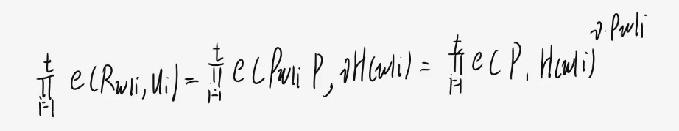
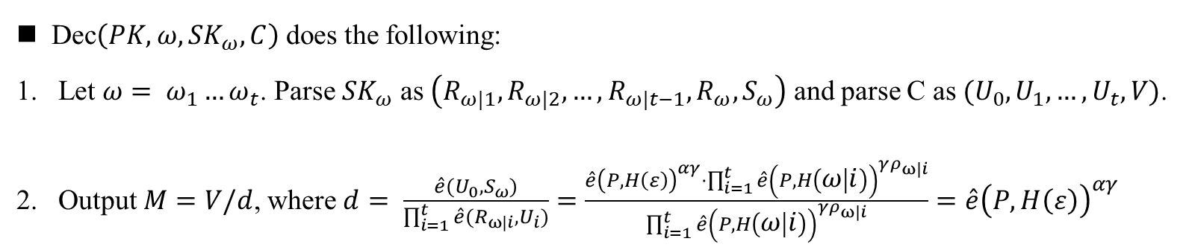
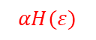

Binary tree encryption
$$αH(ε)$$
$$ℰ$$
$$ρ_{0}H(0)+ αH(ε)$$
$$0$$
$$1$$
$$ρ_{0}H(0)+ρ_{01}H(01)+ αH(ε)$$
$$00$$
$$01$$
$$10$$
$$11$$
$$000$$
$$001$$
$$010$$
$$011$$
$$100$$
$$101$$
$$110$$
$$111$$
Dec$\left(PK,ω,SK_{ω},C\right)$ does the following:
Let $ω= ω_{1}…ω_{t}$. Parse $SK_{ω}$ as $\left(R_{ω|1},R_{ω|2}, …,R_{ω|t−1},R_{ω},S_{ω}\right)$ and parse C as $(U_{0},U_{1},…,U_{t},V)$.
Output $M=V/d$, where $d= \frac{\hat{e}(U_{0}, S_{ω})}{\prod_{i=1}^{t}{\hat{e}(R_{ω|i},U_{i})}}=\frac{\hat{e}{\left(P,H\left(ε\right)\right)}^{αγ}⋅\prod_{i=1}^{t}{\hat{e}{\left(P,H\left(ω | i\right)\right)}^{γρ_{ω|i}}}}{\prod_{i=1}^{t}{\hat{e}{\left(P,H\left(ω | i\right)\right)}^{γρ_{ω|i}}}}=\hat{e}{\left(P, H\left(ε\right)\right)}^{αγ}$
[1] Canetti R, Halevi S, Katz J. A forward-secure public-key encryption scheme[C]//Advances in Cryptology—EUROCRYPT 2003.

Slide 11
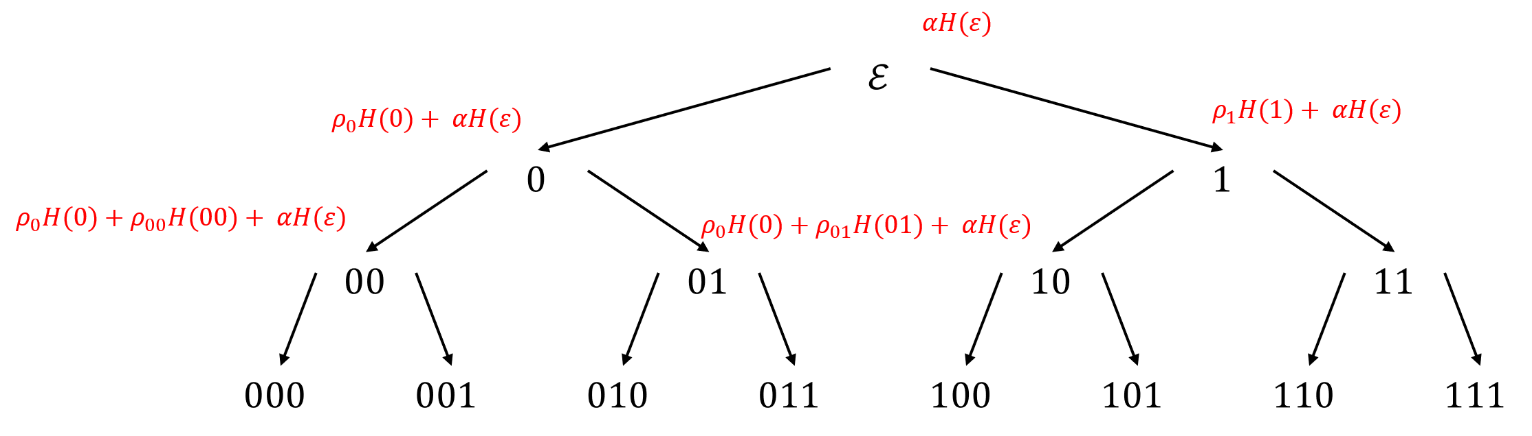
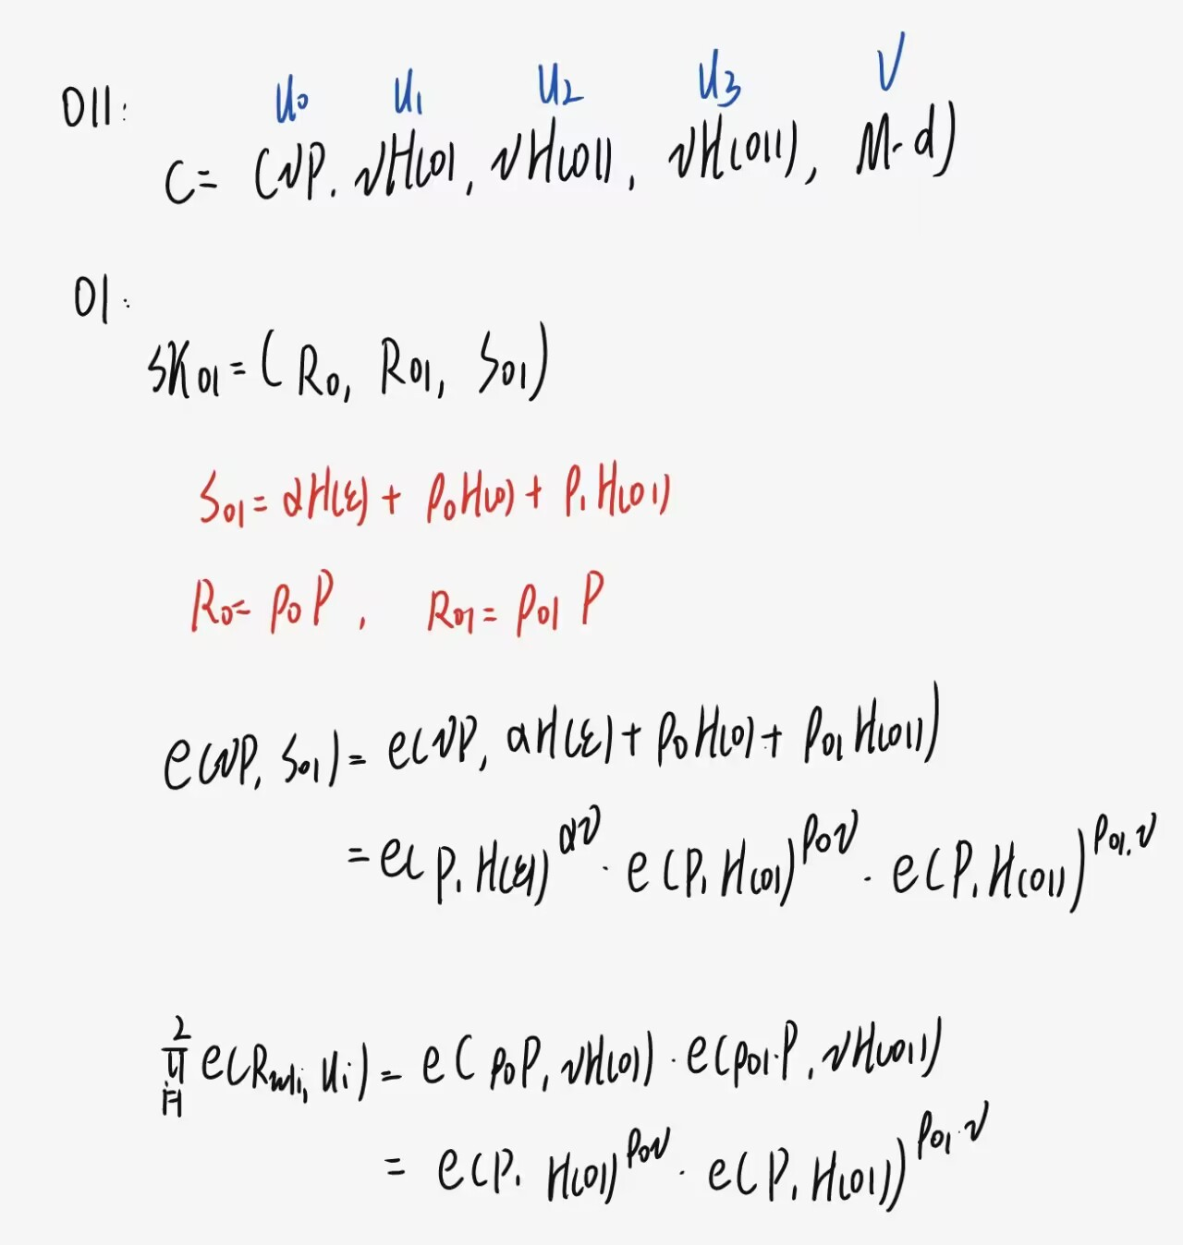
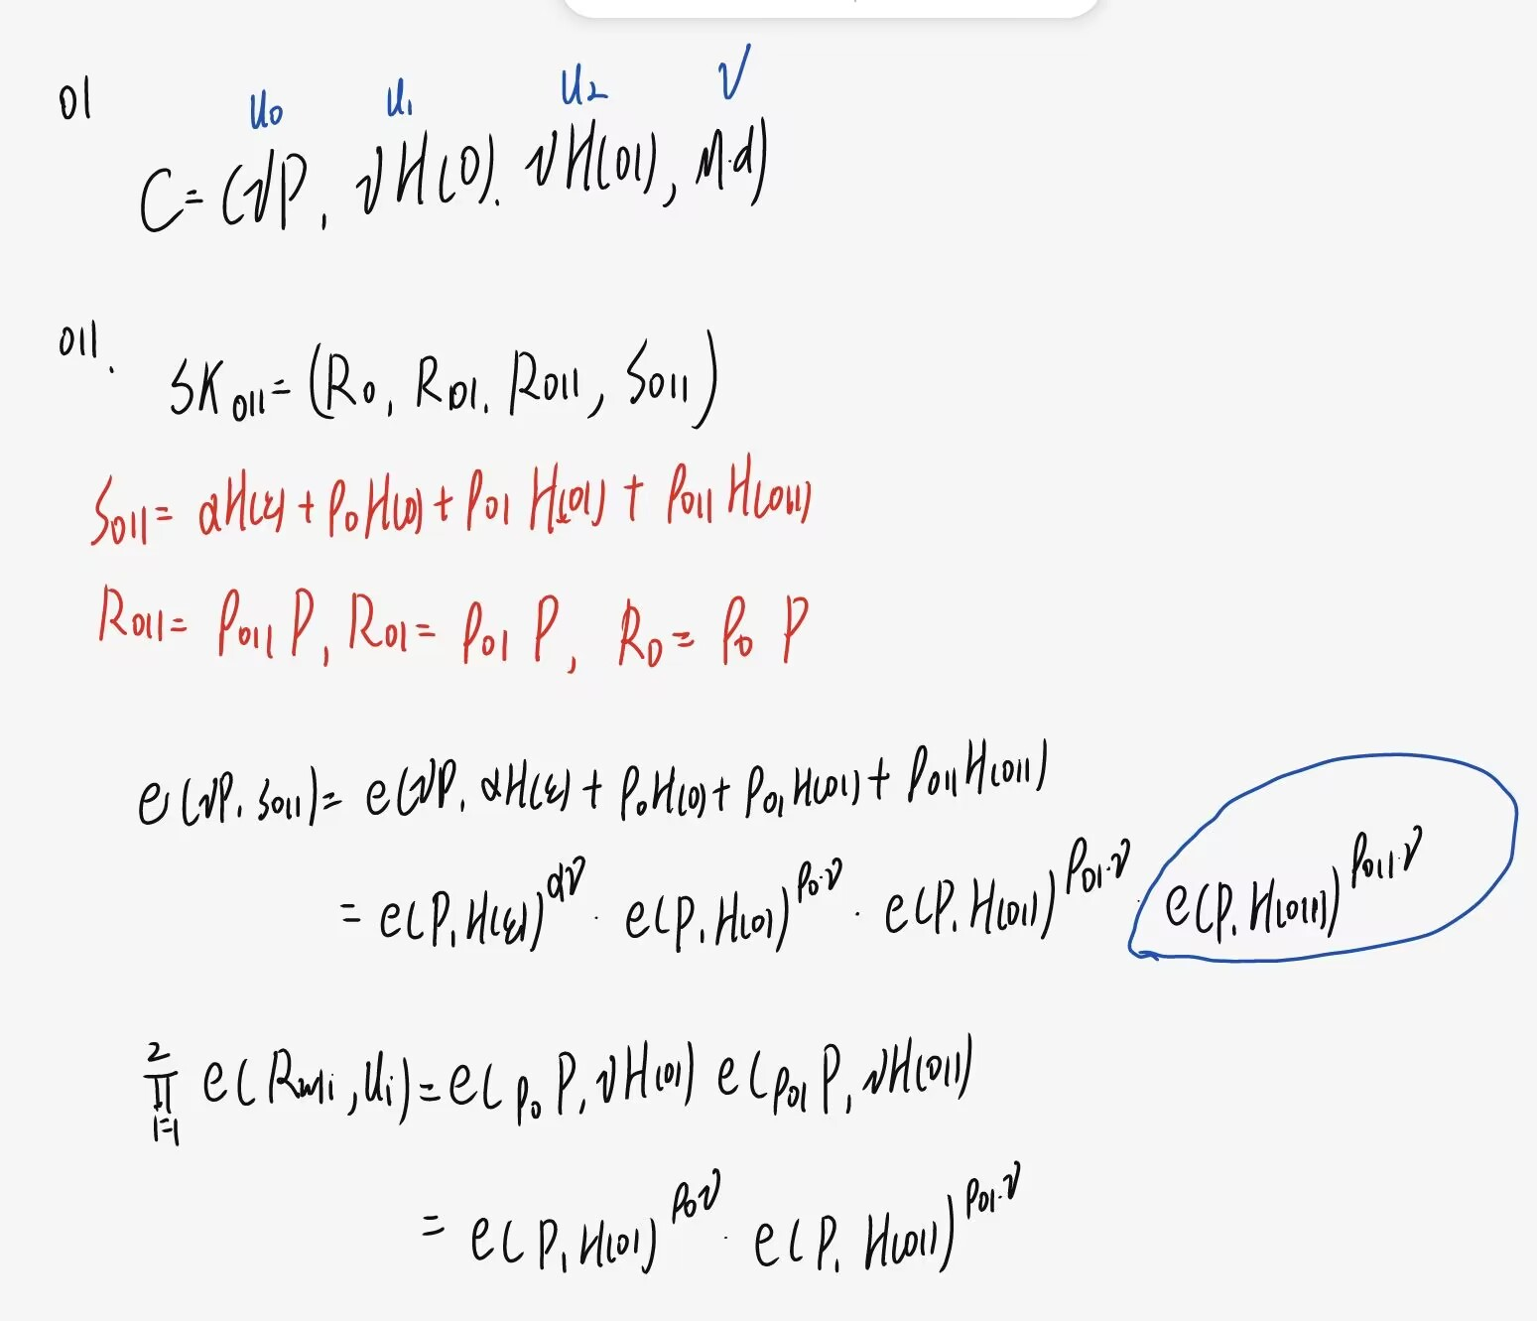

Slide 12
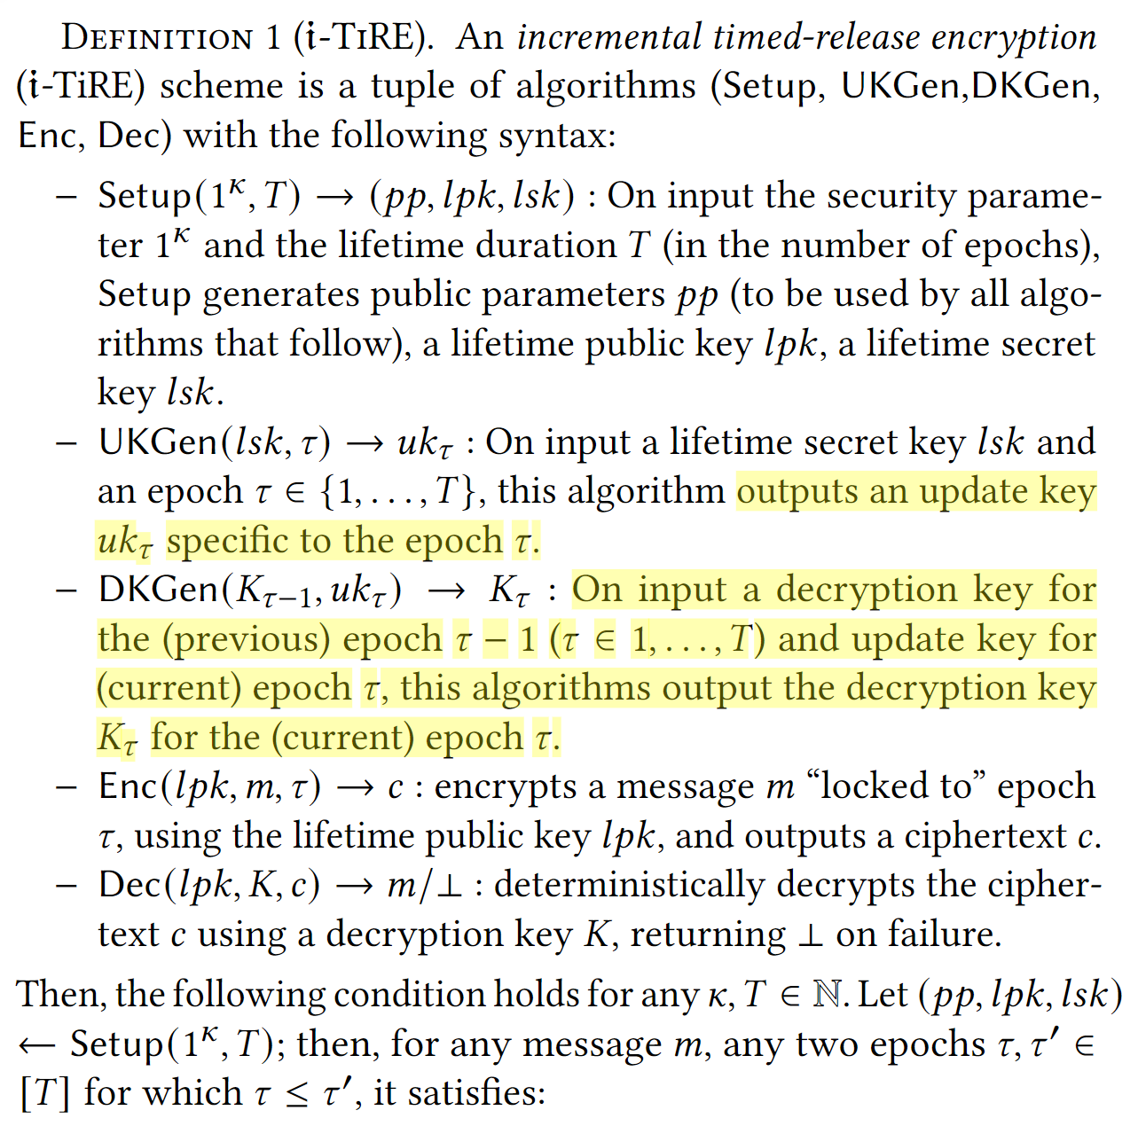
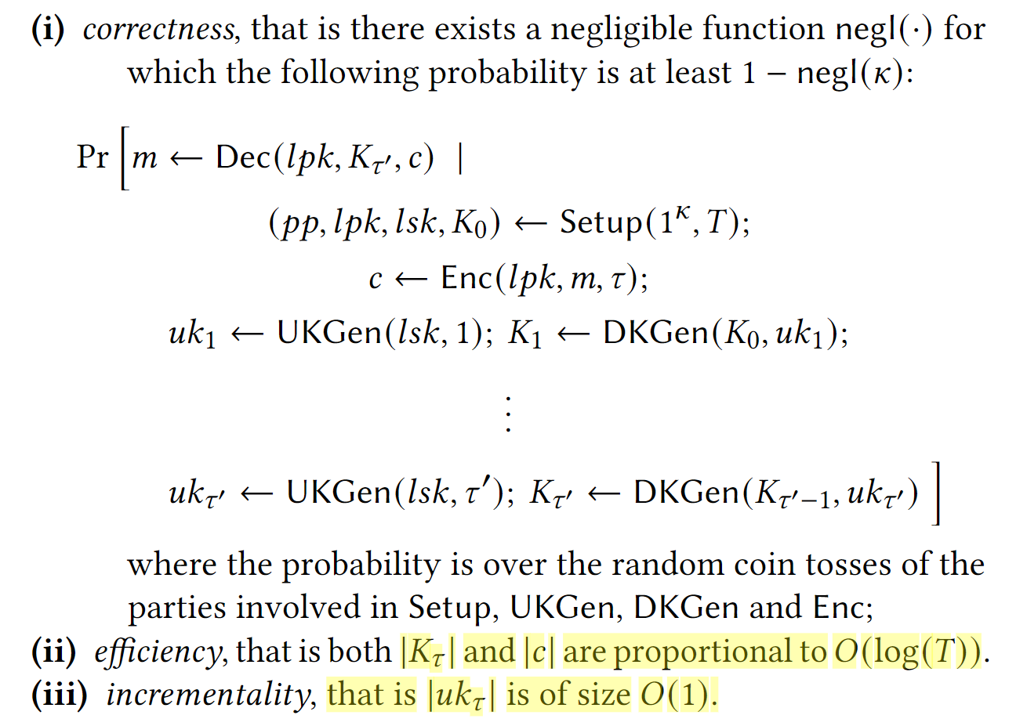
Incremental Timed-Release Encryption (𝔦-TiRE)

Slide 13
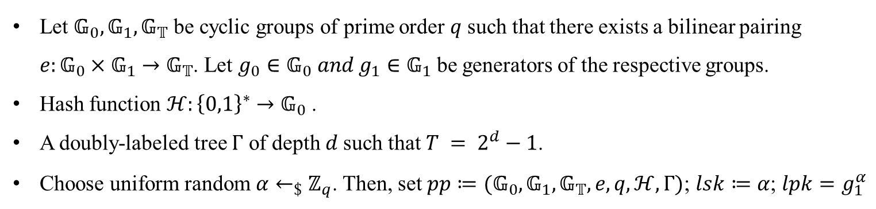
Incremental Timed-Release Encryption (𝔦-TiRE)
15
 Setup$\left(1^{k},T\right)→\left(pp,lpk,lsk\right)$
$$ℰ$$
7
14
$$0$$
$$1$$
3
6
10
13
$$00$$
$$01$$
$$10$$
$$11$$
1
2
4
5
8
9
11
12
$$000$$
$$001$$
$$010$$
$$011$$
$$100$$
$$101$$
$$110$$
$$111$$
Let $𝔾_{0}, 𝔾_{1},𝔾_{𝕋}$ be cyclic groups of prime order 𝑞 such that there exists a bilinear pairing $e:𝔾_{0}×𝔾_{1}→𝔾_{𝕋}$. Let $g_{0}∈𝔾_{0} and g_{1}∈𝔾_{1}$ be generators of the respective groups.
Hash function $ℋ:{\left\{0,1\right\}}^{∗}→𝔾_{0}$ .
A doubly-labeled tree $Γ$ of depth 𝑑 such that $T = 2^{d}−1$.
Choose uniform random $α←_{\$}ℤ_{q}$. Then, set $pp≔(𝔾_{0},𝔾_{1},𝔾_{𝕋},e,q,ℋ,Γ)$; $lsk≔α$; $lpk=g_{1}^{α}$

Slide 14
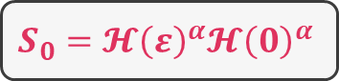

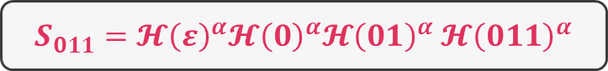
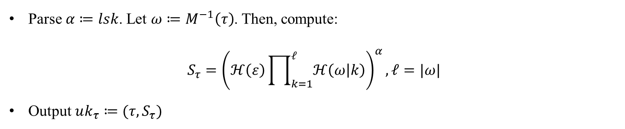
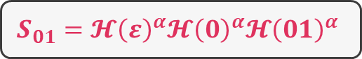
Incremental Timed-Release Encryption (𝔦-TiRE)
15
$$S_{ε}=𝓗{\left(ε\right)}^{α}$$
 UKGen$\left(lsk,τ\right)→uk_{τ}$
$$ℰ$$
7
$$S_{0}=𝓗{\left(ε\right)}^{α}𝓗{\left(0\right)}^{α}$$
14
$$0$$
$$1$$
3
6
$$S_{01}=𝓗{\left(ε\right)}^{α}𝓗{\left(0\right)}^{α}𝓗{\left(01\right)}^{α}$$
10
13
$$00$$
$$01$$
$$10$$
$$11$$
1
2
4
5
$S_{011}=𝓗{\left(ε\right)}^{α}𝓗{\left(0\right)}^{α}𝓗{\left(01\right)}^{α}$ $𝓗{\left(011\right)}^{α}$
8
9
11
12
$$000$$
$$001$$
$$010$$
$$011$$
$$100$$
$$101$$
$$110$$
$$111$$
Parse $α≔lsk$. Let $ω≔M^{−1}\left(τ\right)$. Then, compute:
$$S_{τ}={\left(ℋ\left(ε\right)\prod_{k=1}^{ℓ}{ℋ\left(ω | k\right)}\right)}^{α}, ℓ=|ω|$$
Output $uk_{τ}≔(τ,S_{τ})$

Slide 15

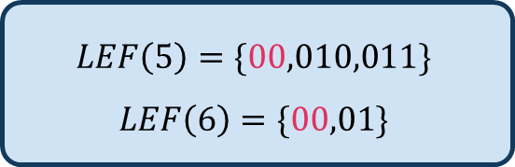
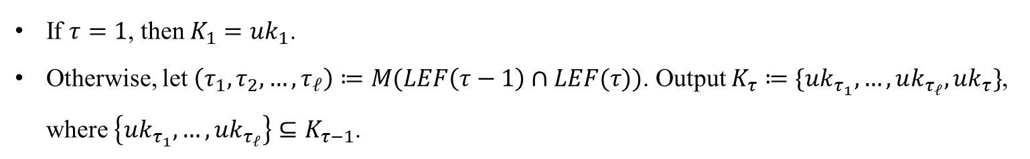
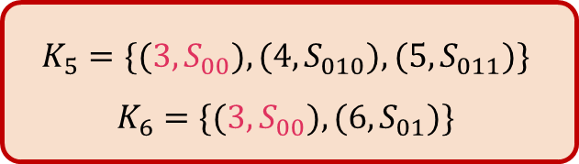
Incremental Timed-Release Encryption (𝔦-TiRE)
15
 DKGen$\left(K_{τ−1},uk_{τ}\right)→K_{τ}$
$$ℰ$$
7
14
$$0$$
$$1$$
3
6
10
13
$$00$$
$$01$$
$$10$$
$$11$$
1
2
4
5
8
9
11
12
$$000$$
$$001$$
$$010$$
$$011$$
$$100$$
$$101$$
$$110$$
$$111$$
If $τ=1$, then $K_{1}=uk_{1}$.
Otherwise, let $\left(τ_{1},τ_{2},…,τ_{ℓ}\right)≔M(LEF\left(τ−1\right)∩LEF(τ))$. Output $K_{τ}≔\{uk_{τ_{1}},…,uk_{τ_{ℓ}},uk_{τ}\}$, where $\left\{uk_{τ_{1}},…,uk_{τ_{ℓ}}\right\}⊆K_{τ−1}$.
$$LEF\left(5\right)=\{00,010,011\}$$
$$LEF\left(6\right)=\{00,01\}$$
$$K_{5}=\{(3,S_{00}),(4,S_{010}),(5,S_{011})\}$$
$$K_{6}=\{({3,S}_{00}),(6,S_{01})\}$$

Slide 16
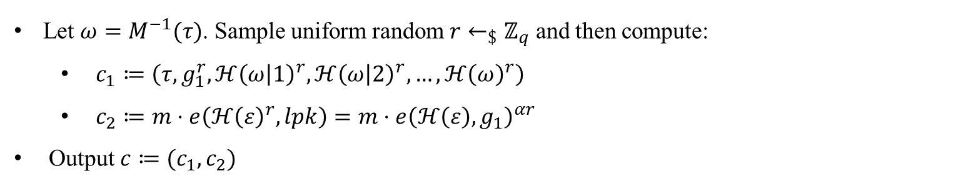
Incremental Timed-Release Encryption (𝔦-TiRE)
15
 Enc$\left(lpk,m,τ\right)→c$
$$ℰ$$
7
14
$$0$$
$$1$$
3
6
10
13
$$00$$
$$01$$
$$10$$
$$11$$
1
2
4
5
8
9
11
12
$$000$$
$$001$$
$$010$$
$$011$$
$$100$$
$$101$$
$$110$$
$$111$$
Let $ω=M^{−1}(τ)$. Sample uniform random $r←_{\$}ℤ_{q}$ and then compute:
$c_{1}≔\left(τ,g_{1}^{r},ℋ{\left(ω | 1\right)}^{r},ℋ{\left(ω | 2\right)}^{r},…,ℋ{\left(ω\right)}^{r}\right)$
$c_{2}≔m⋅e\left(ℋ{\left(ε\right)}^{r},lpk\right)=m⋅e{\left(ℋ\left(ε\right),g_{1}\right)}^{αr}$
Output $c≔(c_{1},c_{2})$

Slide 17
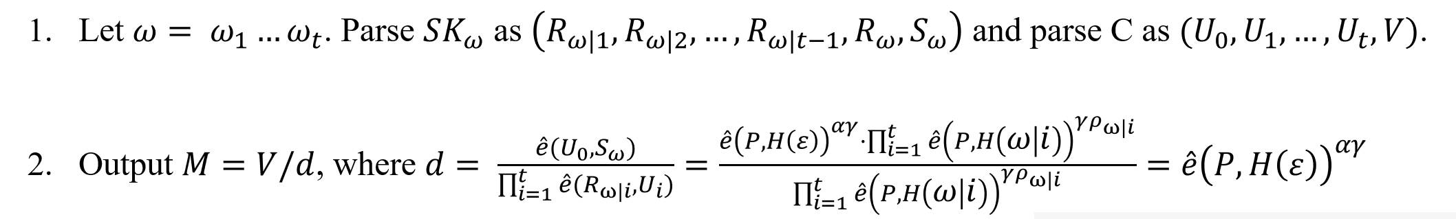

Incremental Timed-Release Encryption (𝔦-TiRE)
15
 Dec$\left(lpk,K,c\right)=:m/⊥$
$$ℰ$$
7
14
$$0$$
$$1$$
3
6
10
13
$$00$$
$$01$$
$$10$$
$$11$$
1
2
4
5
8
9
11
12
$$000$$
$$001$$
$$010$$
$$011$$
$$100$$
$$101$$
$$110$$
$$111$$
Parse $c$ as $(c_{1},c_{2})$, where $c_{1}≔(τ^{′},R,h_{1},…,h_{ℓ})$ and $c_{2}:=m⋅e{\left(ℋ\left(ε\right),g_{1}\right)}^{αr}$, parse $\left(\left(τ_{1},S_{1}\right),…,\left(τ_{η+1},S_{η+1}\right)\right)≔K$. If $τ^{′}>τ_{η+1}$ then output $⊥$ else go to next step;
Identify the unique $(τ_{i}, S_{i})$ such that either $τ_{i}=τ′$ or $ω_{i}≔M^{−1}(τ_{i})$ is a prefix of $ω^{′}≔M^{−1}(τ′)$;
Set $d≔e\left(S_{i},R\right)⋅{\left(\prod_{i=1}^{ℓ_{i}}{e\left(h_{i},lpk\right)}\right)}^{−1}$ where $ℓ_{i}≔|ω_{i}|$;
Output $m≔c_{2}⋅d^{−1}$

Slide 18



平衡二叉树的左子树和右子树的高度差的绝对值不超过1，并且它的左子树和右子树都是平衡二叉树
Drawbacks of Unbalanced Trees

Slide 19


Threshold 𝔦-TiRE

Slide 20


Threshold 𝔦-TiRE

Slide 21



Threshold 𝔦-TiRE

Slide 22

CCA-security
 Fujisaki-Okamoto transformation
A symmetric-key encryption scheme $(SE.Enc, SE.Dec)$ that takes ${\left\{0,1\right\}}^{k}$ bit key.
Two hash functions $ℋ_{1}:𝔾_{𝕋}→{\left\{0,1\right\}}^{k}$ and $ℋ_{2}:𝔾_{𝕋}×{\left\{0,1\right\}}^{∗}×{\left\{0,1\right\}}^{∗}→ℤ_{q}$ modeled as random oracles.
$Enc^{′}\left(lpk,m,τ\right)→c:Let ω≔M^{−1}(τ)$. Then:
Sample uniform random $s←_{\$}𝔾_{𝕋}$.
Compute $c_{1}←Enc\left(lpk,s,τ;ℋ_{2}\left(s,ω,m\right)\right)$.
Compute $c_{2}←SE.Enc(ℋ_{1}\left(s\right),m)$ where $ℋ_{1}(s)$ is used as the key.
Set $c≔(τ,c_{1},c_{2})$.
$Dec^{′}\left(lpk,K,c\right)→m/⊥$: Parse $\left(τ,c_{1},c_{2}\right)≔c$ and let $ω≔M^{−1}(τ)$ then:
Compute $s := Dec(c_{1})$.
Use $ℋ_{1}(s)$ as the key to decrypt $m := SE.Dec(ℋ_{1}\left(s\right),c_{2})$.
Then, re-encrypt with $ℋ_{2}\left(s,ω,m\right)$ to check whether $c_{1}=Enc\left(lpk,s,τ;ℋ_{2}\left(s,ω,m\right)\right)$. If the check succeeds then output 𝑚 otherwise output $⊥$.

Slide 23




Implementation and evaluation
 实验设置
密文长度扩展（KB）
UKGen运行时间(ms)
解密密钥长度（KB）

Slide 24



Implementation and evaluation
Enc运行时间(ms)
 实验设置
Dec运行时间(ms)

